Slide 1
Selected Topics in Computational Intelligence I
Session Enrichment 1
Solving Clustering Problem

Slide 2
Agenda
Introduction
ACO for clustering
Algorithm ACO
Result

Slide 3
Introduction
This paper presents ACO for optimally clustering N objects into K cluster.
Clustering aims to discover sensible organization of objects in a given dataset by identifying and quantifying similarities (dissimilarities) between the objects.

Slide 4
Introduction
Each agent(ant) discovers a possible partition of objects in a given dataset and the level of partitioning is measured subject to (Euclidean distance) metric.
Information associated with an agent about clustering of objects is accumulated in the global information hub (pheromone trail) and is used by the other agents to construct possible clustering solutions and iteratively improve them.

Slide 5
Introduction
The aim is obtain optimal assignment of N objects in R^{n} to one of the K clusters such that the sum of squared Euclidean distance between each object ant the center of belonging cluster is minimized.

Slide 6

ACO algorithms for Clustering
An agent starts with an empty solution S of length N where each element of S corresponds to one of test samples.
For ex : A solution S1 is represented below, for N=8, and K=3 :
The valued assigned to an element of solution S the cluster number to which the test sample is assigned in S

Slide 7
ACO algorithms for Clustering
At first, the pheromone matrix, τ is initialized
to some small value, τ0.
τij at location (i, j) represents the pheromone concentration of sample i associated to the cluster j.
For the problem of separating N samples into K clusters the pheromone matrix is of size N × K.

Slide 8
ACO algorithm for Clustering
At iteration level, each ant will develop solution using communication pheromone to obtain near optimal partition of the given N test samples into K groups.
After generating a “trial” solution, a local search is improved fitness of these solutions
The pheromone matrix is updated depending on the quality solution produced by ants.
Ants will improve solution and the above steps are repeated for certain number iterations.

Slide 9
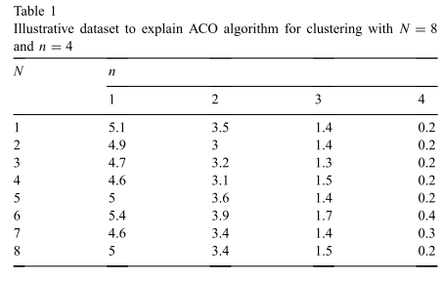
Algorithm by illustrative
Let us consider one illustration.
A dataset containing N=8 test samples defined by n=4 attributes, clustered into K=3 and R=10 agents (ants) .

Slide 10
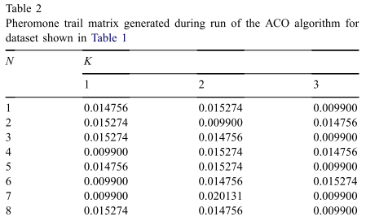
The pheromone concentrations on current iteration
It indicates at current iteration, for sample 1, has the highest probability of belonging to cluster number 2, because τ12 (= 0.15274) is highest

Slide 11
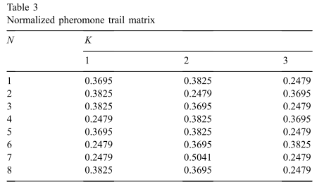
Normalized pheromone trails
0.014576—0.015274– 0.00990
0.3695—0.3825– 0.2479
0.3695—0.7520– 1.0

Slide 12
Generate a solution S
the agent/ant select next cluster number for each element S with following role :
Exploitation→chooses any one of all cluster with match value random generated with the available pheromone on each clusters.
Exploration→chooses any one of all cluster with a normalized pheromone probability/Roulete wheel
To set to be exploitation or exploration, we defined: if random value generated < q0 wil be exploitation, else exploration

Slide 13

exploration
where pij is the normalized pheromone probability for element i belongs to cluster j.

Slide 14
Example qo=0.98
Generated random for 8 elements
1- 0.693→exploitation→cluster 2
2- 0.091→ exploitation→cluster 1
3-0.986 → exploration→cluster 3
4-0.988 → exploration→cluster 2
5-0.547 → exploitation→cluster 2
6-0.967 → exploitation→cluster 3
7-0.347 → exploitation→cluster 2
8-0.028 → exploitation→cluster 1
Solution Si=2 1 3 2 2 3 2 1

Slide 15
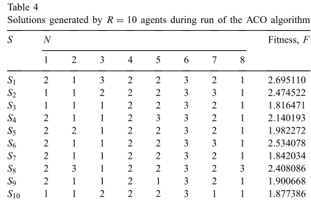
Solution all ants

Slide 16

Fitness/Objective Function
The objective function is defined as the sum of squared Euclidean distances between each object and the center of belonging cluster.

Slide 17
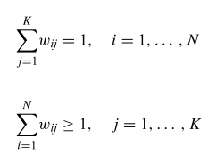
xiv is a value of vth attribute of ith sample;
m a cluster center matrix of size K × n;
mjv an average of the vth attribute values of all samples in the cluster j;
w a weight matrix of size N × K;
wij an associated weight of object xi with cluster j

Slide 18
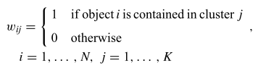
wij can be assigned as

Slide 19

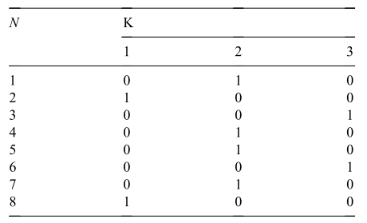
For Solution S1
w11 = 0, w12 = 1, w13 = 0. So, weight matrix can be given as

Slide 20

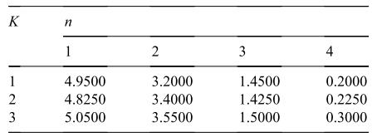
center of each cluster, mj can be obtained as
Center cluster 1= (1X4.9) + (1X5) /2
= 4.95

Slide 21
Local search
We conduct local search to improve solution discovered
Local search is done only on the appropriate best solution (ex: 20 % best).
Changing the clustered number in solution with certain threshold probability, pls.
pls =0.01.
This changing can be accepted only if there is improvement in the fitness.

Slide 22
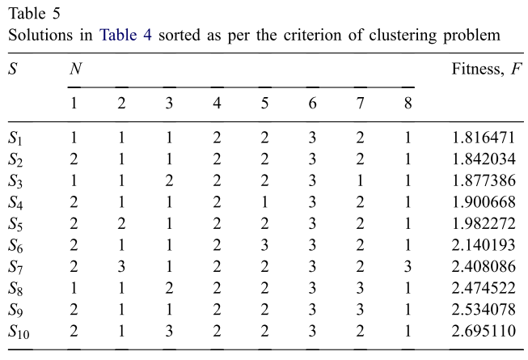
Illustrative of local search
At first, we sort based on the best
20 % best = S1 and S2

Slide 23
For solution 1, we generated 8 random number, say (0.231345, 0.742312, 0.655361, 0.198312, 0.001636,0.1278345, 0.874452, 0.436587)
It means that only element 5 (0.001636) < 0.01, so element 5 will swap with by random probability
By the above method, on solution 2, for instance element 7 will be swapped

Slide 24
S1→element 5 swapped S2→element 7 swapped
Before
After
LS1 and LS2 will be accepted if better (less) than S1 and S2 .

Slide 25

Pheromone update
The trail updating process applied in this algorithm considers best L solutions out of R members discovered by the agents as per the given criterion at iteration level t.
= 1/Fl , if cluster j is assigned to ith element of the solution constructed by ant l and zero otherwise.

Slide 26
Experiment Result
Using the five datasets (two simulated and three chemical datasets) .
Comparison result with the other algortihm (GA, SA, TS).
Each experiment performs 10 times and at most 1000 iterations.
The solution quality is given in terms of the average and worst values of the clustering
metric (Favg, Fworst, respectively)

Slide 27
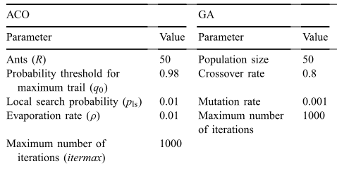
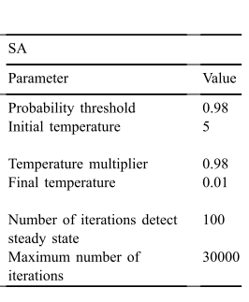
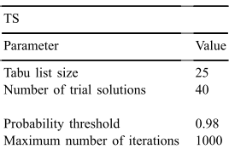
Value parameter of 4 algorithm

Slide 28
Dataset 1
This dataset is composed of K = 3 clusters with 50 objects in each cluster.
The data was generated using mean µ1 = [3,0], µ2 = [0, 3], µ3 = [1.5, 2.5] and variance λ1 = [0.3, 1], λ2 = [1, 0.5], λ3 = [2, 1].

Slide 29
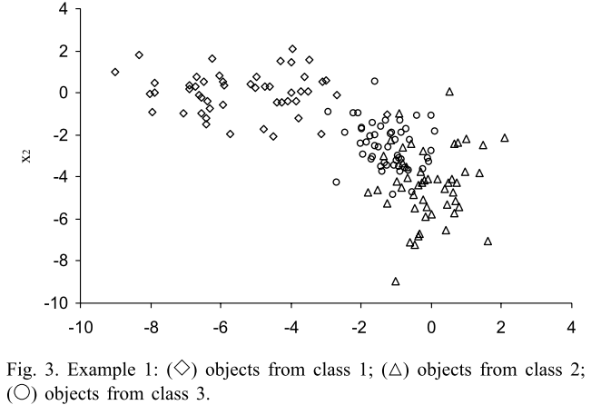
Dataset 1
The data was generated using mean µ1 = [3,0], µ2 = [0, 3], µ3 = [1.5, 2.5] and variance λ1 = [0.3, 1], λ2 = [1, 0.5], λ3 = [2, 1].

Slide 30
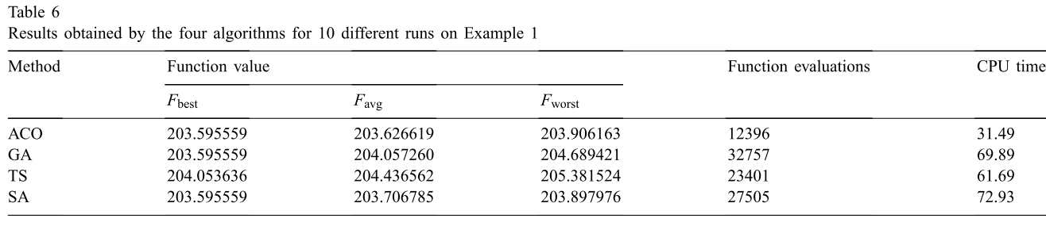
Result Dataset 1
Optimum value=203
Function evaluation=The average number to obtain the best solution.

Slide 31
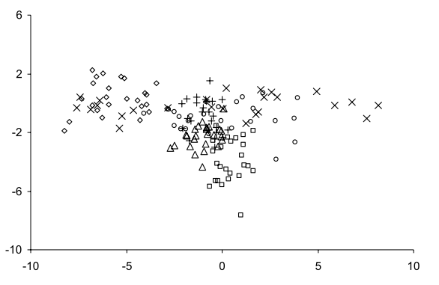
Dataset 2
The dataset represents K = 6 clusters with allocation of 25 objects to each cluster. The data was simulated using mean values µ1 = [3, 0], µ2 = [0, 3], µ3 = [1.5, 2.5], µ4 = [0.2, 0.1], µ5 = [1.2, 0.8], µ6 =[0.1, 1.1] and variance λ1 = [0.3, 1], λ2 = [1, 0.5], λ3 = [2, 1], λ4 = [0.03, 1], λ5 = [2, 0.5], λ6 = [0.2, 0.4].

Slide 32
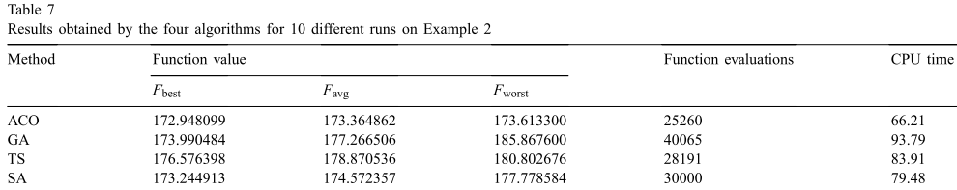
Result dataset 2

Slide 33
Dataset 3=iris dataset. The dataset consists of N = 150 samples of three iris flowers (K = 3) Each object is defined by four attributes, n = 4:
sepal length, sepal width, petal length, and petal width.
Dataset 4=wines. K=3, N=178, n=13
Dataset 5=human thyroid diseases, K=3, N=215, n=5

Slide 34
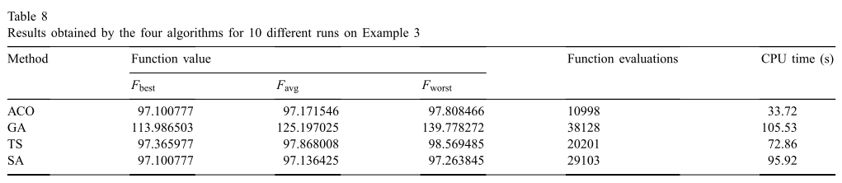
Dataset 3

Slide 35
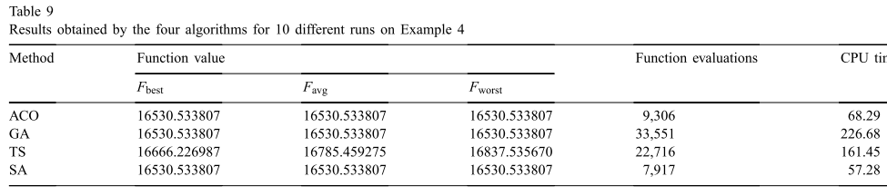
Dataset 4

Slide 36
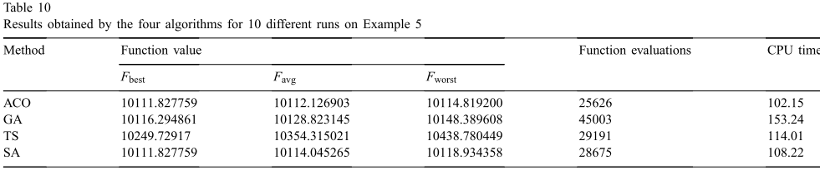
Dataset 5

Slide 37
References
Andries P. Engelbrect. (2007), Computational Intelligence An Introduction. 2nd Ed. John Wiley & Sons. USA. ISBN: 978-0-470-03561-0
James M. Keller, Derong Liu, David B. Fogel (2016). Fundamentals of Computational Intelligence. Neural Networks, Fuzzy Systems and Evolutionary Computation, Wiley ISBN 978-1-110-21434-2
Bansal, Jagdish Chand, Pramod Kumar Singh, and Nikhil R. Pal . (2017) "Evolutionary and Swarm Intelligence Algorithms", Springer, ISBN 978-3-319-91339-1
Bernhard, Korte, and J. Vygen (2008), "Combinatorial optimization: Theory and algorithms." Springer, Third Edition.

